Slide 1
Chapter 8
Decoupling and Sparse Controls
Process Control
Dr. Cai Wenjian

Slide 2
Outline – Chapter 8
Classical Decoupling Control
  Simplified Decoupler
  Generalized Decoupler
  Inverted Decoupling
  Conditions for decoupling control
Normalized Decoupling
Decoupling Control Implementation
  Steady-State Decoupling
  Robustness
  Condition Number
Sparse Control
Process Control
Dr. Cai Wenjian

Slide 3

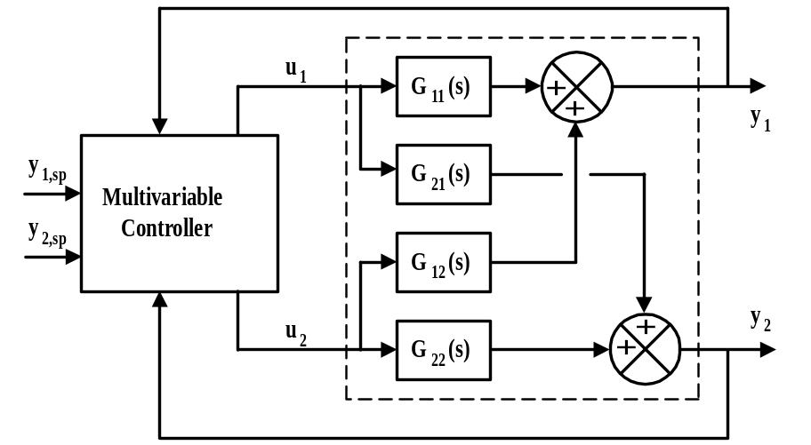
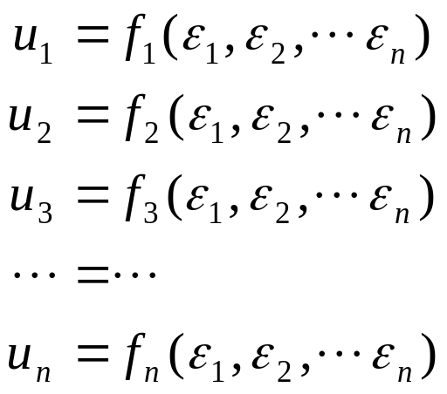
Multi-loop vs. Multivariable Control
Multiloop - use of several single-loop controllers (e.g., PID), used as a base control loops and reside in Distributed Control System (DCS).
    e.g., flow control, temperature control, pressure control
Multivariable - make control decisions jointly considering all outputs, normally require additional computational capability, and sit over a base multi-loop control configuration, sending set-points to the multi-loop controllers.
Multiloop:
Multivariable:
Process Control
Dr. Cai Wenjian

Slide 4
Principles of Decoupling
Main loop y₁ — u₁ , y₂ — u₂,…, y_{n} — u_{n}, couplings
  desirable for control
Cross-couplings, y_{i} — u_{j} (i ≠ j)
  undesirable; loop interactions
Eliminates effect of undesired cross-couplings
  improve control performance.
Objective is to compensate for interactions by cross-couplings
  not to “eliminate” cross-couplings; impossibility, require altering physical nature of system.
Process Control
Dr. Cai Wenjian

Slide 5
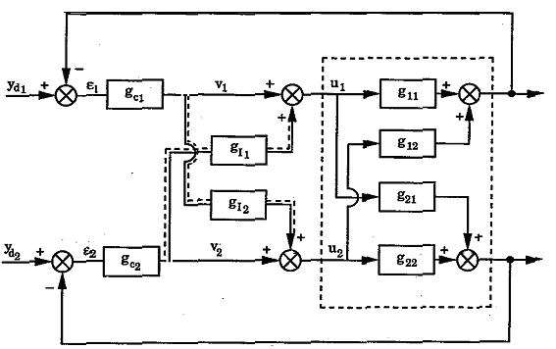
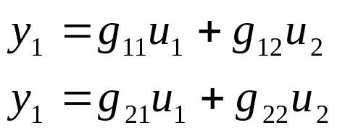
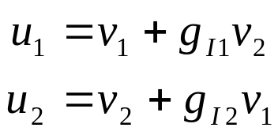

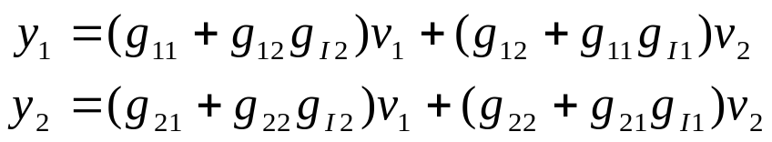
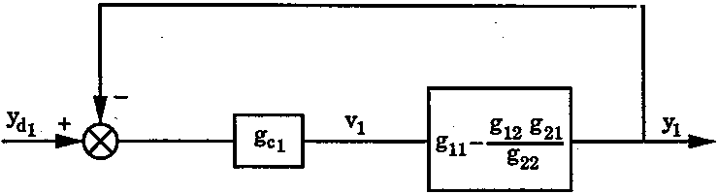


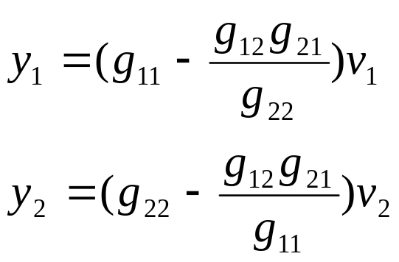
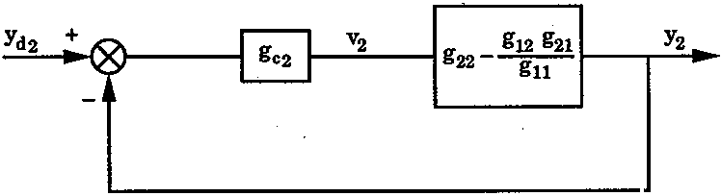
Simplified Decoupling
Process Control
Dr. Cai Wenjian

Slide 6
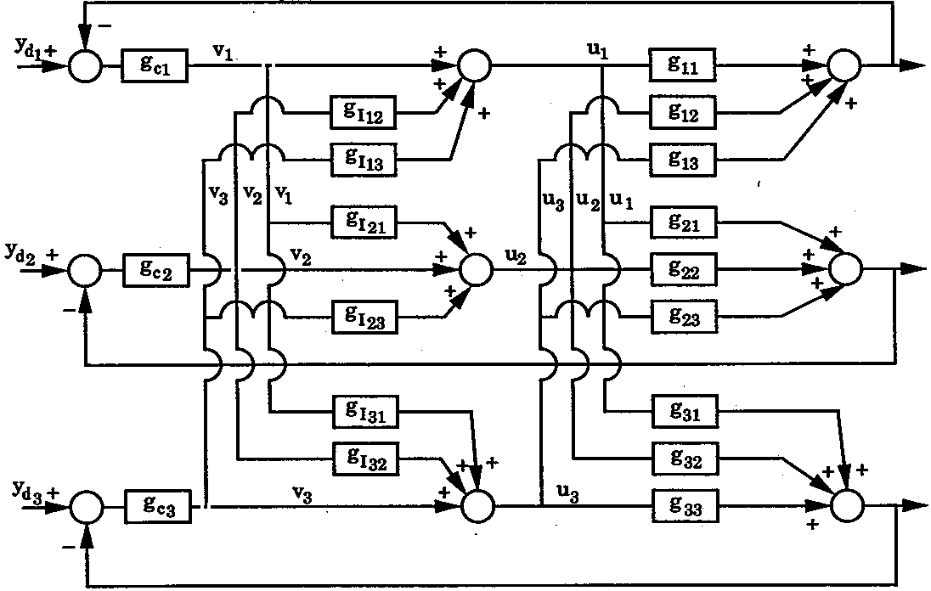
Difficulties for Simplified Decoupler
3×3 , six compensator.
N×N: (N²-N) compensators.
Larger than 2 x 2, decoupling become tedious.
Process Control
Dr. Cai Wenjian

Slide 7






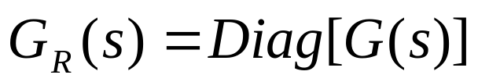
Generalized Decoupling
MIMO process
To eliminate interactions, y to v : a diagonal matrix; G_{R}(s).
Choose G_{I} such that
Selected to provide desired decoupled behavior with the simplest form
  A commonly employed choice
Process Control
Dr. Cai Wenjian

Slide 8
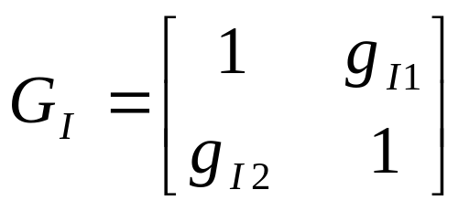
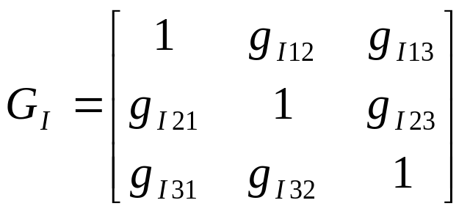
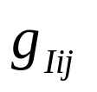
Relation Between the Two Schemes
Simplified decoupling
2 x 2 and 3 x 3 system, the compensator transfer function matrix:
For the desired G_{I} , task is to find
to make GG_{I} diagonal
General decoupling
Final diagonal form GG_{I} specified as G_{R}, then G_{I} can be derived.
Process Control
Dr. Cai Wenjian

Slide 9
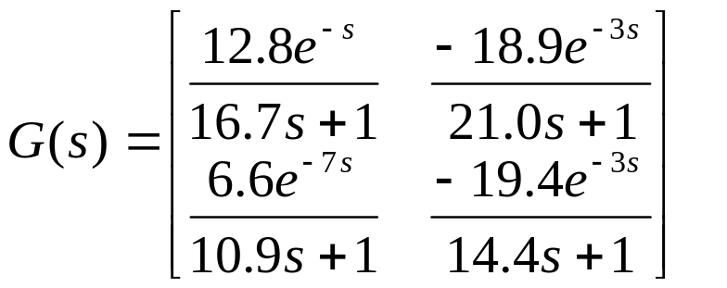
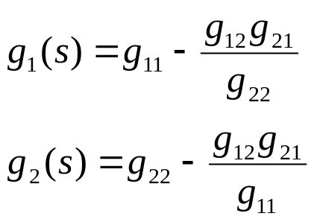
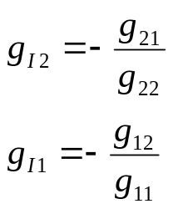
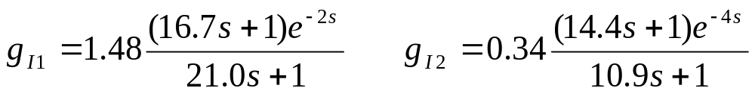
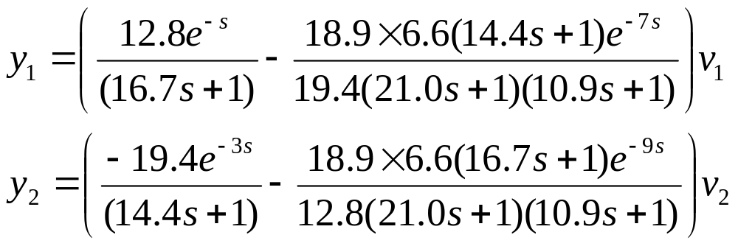
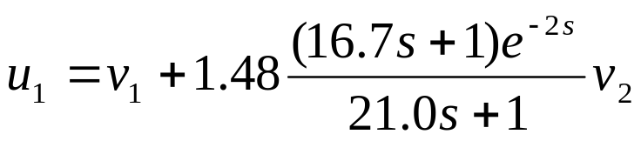
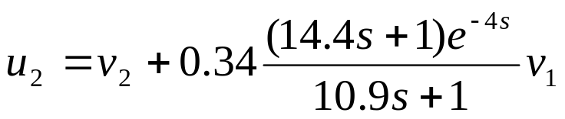
Example: Distillation Column
simplified decoupler
actual implementation
Process Control
Prof. Cai Wenjian

Slide 10
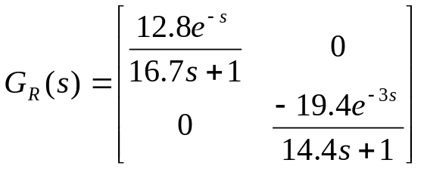
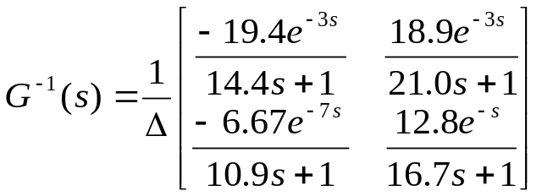
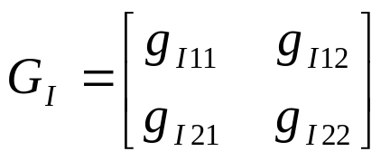
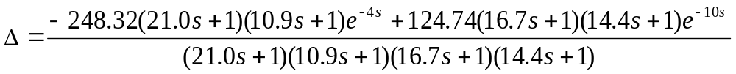
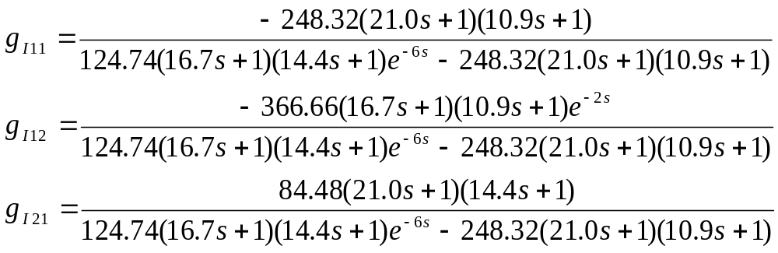



Example: Distillation Column
Generalized decoupling:
The actual implementation:
Process Control
Prof. Cai Wenjian

Slide 11
Comparison of the Two Methods
Simplified decoupling: much more complicated than G_{R} specified in the Generalized decoupling
Difficult to tune controller
Generalized decoupling: tuning and performance better than for Simplified decoupling
Complicated decoupler
Process Control
Dr. Cai Wenjian

Slide 12
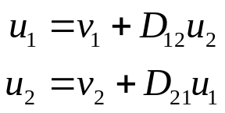
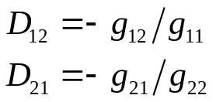
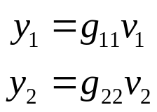
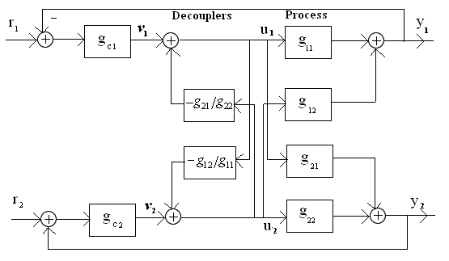
Inverted Decoupling
The required decouplers are the same for the simplified decoupling
The apparent process is the same as generalized decoupling
Process Control
Dr. Cai Wenjian

Slide 13
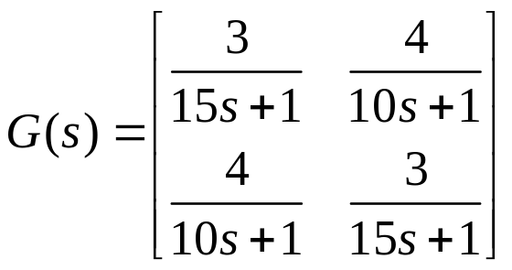
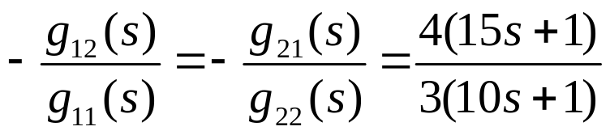
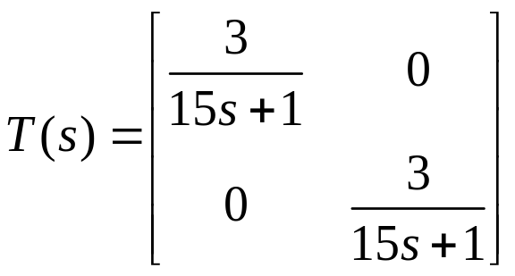
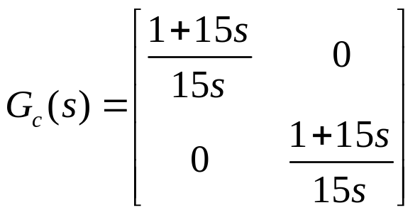
Example
Transfer matrix
Time constant of five time
Process Control
Dr. Cai Wenjian

Slide 14


Steady-State Decoupling
Steady-state gain for decouplers
2×2 system
Simplified steady-state decoupling
Generalized steady-state decoupling
Controller design: assume loops have been decoupled
Very easy to design and implement, first technique to try;
  ideal decoupler only if dynamic interactions persistent
  big performance improvements with very little work or cost
  most often applied in practice.
Process Control
Dr. Cai Wenjian

Slide 15
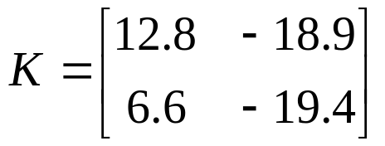

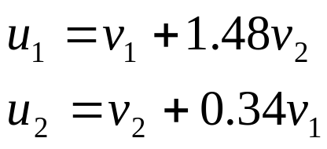
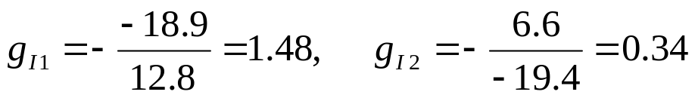
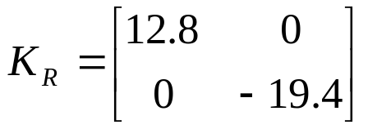
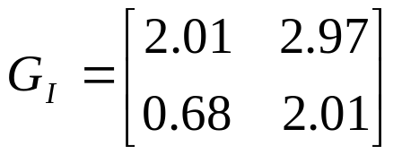
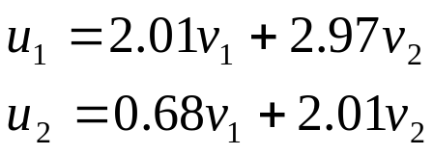
Example Distillation Column
Simplified steady-state decoupling
Generalized steady-state decoupling
Process Control
Dr. Cai Wenjian

Slide 16


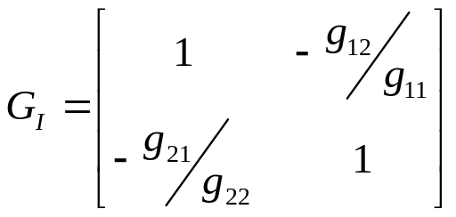
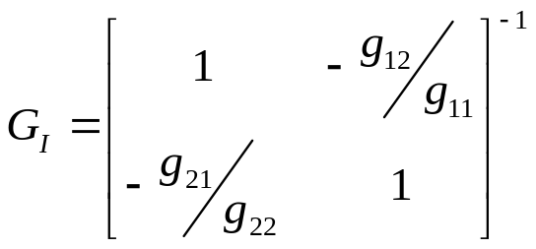

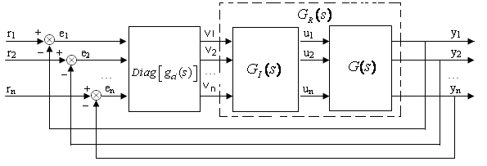
Decoupling Control Structure
Introducing additional transfer function block
Transfer function matrix
is diagonal.
Ideal decoupling
Simplified decoupling
Inverted decoupling
Process Control
Dr. Cai Wenjian

Slide 17



Principals
from
Problem statement: determine
Such that
Realizable: no future values of its input are required to determine its output
Stable: decoupler transfer function must be stable.
Properness: order denominator of decoupler is higher than numerators.
Robustness: so be robust to the parameter variations.
Process Control
Dr. Cai Wenjian

Slide 18
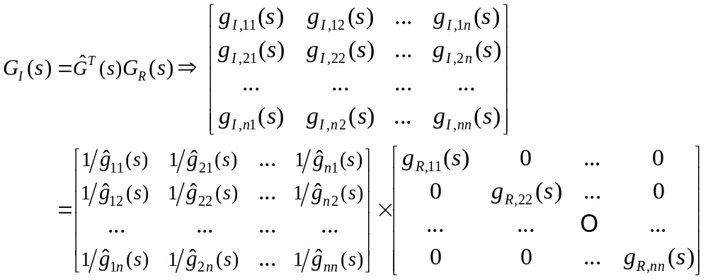
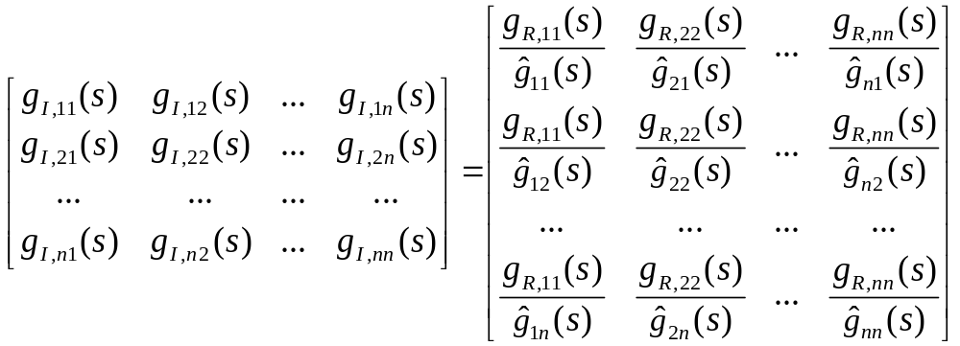
Normalized Decoupling Control Structure
Process Control
Dr. Cai Wenjian

Slide 19
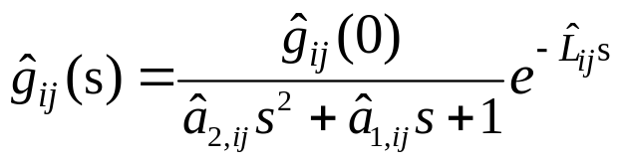
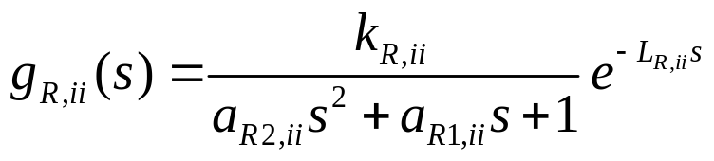
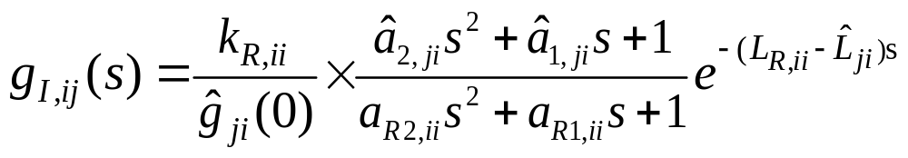
Parameterization
Assuming
Making
The element of the resultant decoupler will have the form
Process Control
Dr. Cai Wenjian

Slide 20

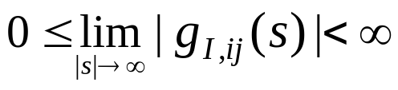
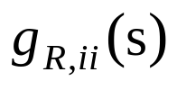





Parameterization
.
.
Stability:
all poles of
must lie in the open Left-Half Plane
Properness:
order higher than or equal to the orders of all
Causality:
satisfied by letting
designed by elements of
Process Control
Dr. Cai Wenjian

Slide 21







Example
Process Control
Dr. Cai Wenjian

Slide 22






Robustness
Process Control
Dr. Cai Wenjian

Slide 23



Robustness
Process Control
Dr. Cai Wenjian

Slide 24







Sensitivity to Model Error
K: system steady-state gain matrix:
Generalized decoupler
ΔK - error in the estimate of the steady-state gain matrix, then
Process Control
Dr. Cai Wenjian

Slide 25

Sensitivity to Model Error
If |K| very small, its reciprocal will be very large
Small modeling errors will cause very large errors in y
Small changes in controller output v result in large errors in y
Decoupling difficult: input/output variables are paired on very large RGA values; system will also be very sensitive to modeling errors.
C_{ij} cofactor of K_{ij}
Process Control
Dr. Cai Wenjian

Slide 26




Example Heavy Oil Fractionator
Transfer function model
determinant very close to zero: decoupling very difficult.
RGA
Decoupling extremely difficult
small value of gain matrix determinant
large values of RGA elements
Process Control
Dr. Cai Wenjian

Slide 27



SVD and Condition Number
Matrix is singular, determinant is zero
Near singularity matrix: singular values
Condition number: The ratio of the largest and smallest singular value
Example: Heavy Oil Fractionator continued
singular values σ₁=5.978, σ₂ = 0.00878 and a condition number:
clearly indicating serious ill-conditioning.
Process Control
Dr. Cai Wenjian

Slide 28



Sparse Control
Main controllers (Diagonal): These controllers are to provide desired performance of closed loop control system.
Tracking controller
Off-diagonal controllers: Main task of the off-diagonal controllers is to minimize interactions among loops
Interaction rejection controller
All loops: integrity principle as for decentralized control applies.
Process Control
Dr. Cai Wenjian

Slide 29




Partial decoupling control
Define
Determine
open-loop forward transfer function
Controllers can then be designed
Process Control
Dr. Cai Wenjian

Slide 30





Example
,
,
Process Control
Dr. Cai Wenjian

Slide 31





Since
ETFs for these transfer functions are obtained as:
.
Process Control
Dr. Cai Wenjian

Slide 32




Response Curve
Process Control
Dr. Cai Wenjian

